Slide 1
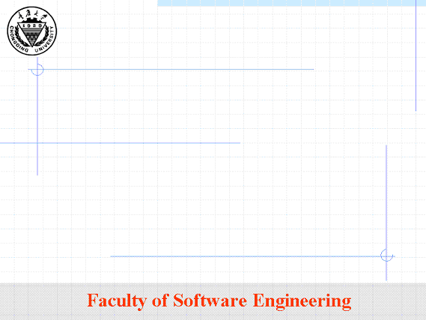
Chapter 2
Requirements from the Customer’s Perspective
Instructor: Zhang yi
  Email: SR_homework@163.com

Slide 2
Chapter 2
Requirements from the Customer’s Perspective
Insufficient Customer
Incomplete Software Requirement and Specification
Reasons of project failure:
---- "The project is steered to success
by the customer and programmers
working in concert"

Slide 3
Who Is the Customer?

Slide 4
Who Is the Customer?
A customer:
is an individual or organization who derives either direct or indirect benefit from a product.

Slide 5
了解客户、最终用户、间接用户
1. 基本概念
  “用户” 是一种泛称，
  它可细分为: “客户”（customer）
  “最终用户”（the end user）
  “间接用户”（或称为关系人）。
  掏钱买软件的用户称为客户，而真正操作软件的用户叫最终用户。客户与最终用户可能是同一个人也可能不是同一个人。

Slide 6
客 户
2. 客户是掏钱买软件的人，所以他是“上帝”
例如：
  某饭店经理在解释“先有鸡还是先有蛋”这个哲学问题时，精辟地阐述了客户的地位：
    如果顾客先点鸡，那么就先有鸡；如果顾客先点蛋，那么就先有蛋。

Slide 7
“现代营销学之父”菲利普•科特勒所著的《市场营销导论》是这样描述客户的：
    客户永远是本公司的座上客。
    客户并不依赖我们，而我们却依赖客户。
    客户不是我们工作的障碍，而是我们工作的目标。
    我们并不因为服务于他而对他有恩，他却因为给予我们服务于他的机会而有恩于我们。
    客户不是我们要与之争辩和斗智的人。从未有人曾在与客户的争辩中获胜。
    客户是把他的欲望带给我们的人，因此我们的工作就是满足这些欲望，从而使客户和我们共同获益。
  与客户打交道的主要目的是：一是获取需求，二是签合同。

Slide 8
最终用户
3. 即使最终用户不是上帝，也算是“上帝”的“亲戚”，同样怠慢不得。
  如果项目规模比较大，那么开发方与最终用户的来往就比较多。如从最终用户那里获取详细的需求，请最终用户试验软件，对最终用户进行培训等等。
  公司新员工上产品培训课，有位小领导匆匆赶来作指示：“隔壁班正在给电信局的员工们进行培训，他们都是上帝派来的，大家要注意形象。由于休息室空间有限，请大家自觉让位。午休时他们可以躺着睡，我们只能坐在位置上打个盹儿…….。”

Slide 9
间接用户
  4. 重视“间接用户”，千万别“大意失荆州” 。
  间接用户既不掏钱买该软件产品，也不使用该软件，但是它可能对软件产品有很大的影响。
  例如：
  财务软件开发商在把“财务软件”卖给客户之前，这个“财务软件”必须得到国家财政部的批准。
  否则，即使该软件的功能是完美的，但却被政府认为是非法的。所以，国家财政部就是所有财务软件的间接用户，它不仅不付钱给财务软件开发商，反而要收取鉴定费、手续费等。

Slide 10
间接用户
  同理，市面上流通的信息安全软件、杀病毒软件必须得到国家公安部的批准，否则软件开发商被逮住后戴上“非法经营”的帽子就惨了。

Slide 11
Customers
is paying for or sponsoring a software project.
defining the business requirements
provide the high-level concept for the product and the business
Establishing the Product Vision and Product Scope
business requirements don’t provide sufficient detail to tell developers what to build.

Slide 12
End user
actually use the product, directly or indirectly.
describe the tasks they need to perform with the product .
characteristics they expect the product to exhibit

Slide 13
2.2 The Customer-Development Partnership
High-quality requirements result from effective communication and collaboration between developers and customers
---- A partnership
---- The Requirements Bill of Rights for Software
Customers
---- The Requirements Bill of Responsibilities for
Software Customers

Slide 14
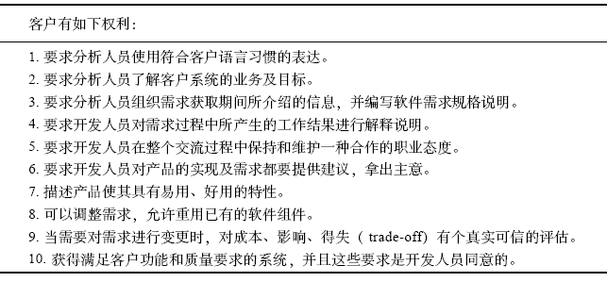
Requirements Bill of Rights for Software Customers

Slide 15
Requirements Bill of Rights for Software Customers
1. Expect analysts to speak your language.
2. Expect analysts to learn about your business and your objectives for the system.
3. Expect analysts to structure the information you present during requirements elicitation into a written software requirements specification.
4. Have analysts explain all work products created from the requirements process.
5. Expect analysts and developers to treat you with respect and to maintain a collaborative and professional attitude throughout your interactions.
6. Have analysts and developers provide ideas and alternatives both for your requirements and for implementation of the product.
7. Describe characteristics of the product that will make it easy and enjoyable to use.
8. Be given opportunities to adjust your requirements to permit reuse of existing software components.
9. Receive good-faith estimates of the costs, impacts, and trade-offs when you request a change in the requirements.
10. Receive a system that meets your functional and quality needs, to the extent that those needs have been communicated to the developers and agreed upon.

Slide 16
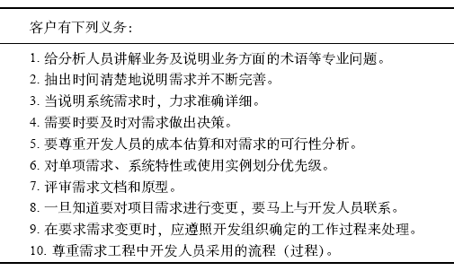
Requirements Bill of Responsibilities for Software Customers

Slide 17
Requirements Bill of Responsibilities for Software Customers
1. Educate analysts and developers about your business and define business jargon.
2. Spend the time that it takes to provide requirements, clarify them, and iteratively flesh them out.
3. Be specific and precise when providing input about the system’s requirements.
4. Make timely decisions about requirements when requested to do so.
5. Respect a developer’s assessment of the cost and feasibility of requirements.
6. In collaboration with the developers, set priorities for functional requirements, system features, or use cases.
7. Review requirements documents and evaluate prototypes.
8. Communicate changes to the requirements as soon as you know about them.
9. Follow the development organization’s process for requesting requirements changes.
10. Respect the processes the analysts use for requirements engineering.

Slide 18
What About Sign-Off ?
Reaching agreement on the requirements for the product
you let me down!
-------------------------------
Agreement helps you forge a collaborative customer-development partnership on the way to project success.

Slide 19
Story :
Gerhard, a senior manager at Contoso Pharmaceuticals, was meeting with Cynthia, the new manager of Contoso’s information systems (IS) development group. “We need to build a chemical-tracking information system for Contoso,” Gerhard began. “The system should let us keep track of all the chemical containers we already have in the stockroom and in individual laboratories. That way, maybe the chemists can get what they need from someone down the hall instead of buying a new container from a vendor. This should save us a lot of money. Also, the Health and Safety Department needs to generate some reports on chemical usage for the government. Can your group build this system in time for the first compliance audit five months from now?”

Slide 20
“I see why this project is important, Gerhard,” said Cynthia. “But before I can commit to a schedule, we’ll need to collect some requirements for your system.”
Gerhard was confused. “What do you mean? I just told you the requirements.”
“Actually, you described a concept and some business objectives for the project,” Cynthia explained. “Those high-level business requirements don’t give me enough detail to know what software to build or how long it might take. I’d like to have a requirements analyst work with some of the users to understand their needs for the system. Then we can figure out what functionality will meet both your business objectives and the users’ needs. You might not even need a new software system to meet your goal of saving money.”

Slide 21
Gerhard hadn’t encountered this reaction before from an IS person. “The chemists are busy people,” he protested. “They don’t have time to nail down every detail before you can start programming. Can’t your people figure out what to build?”
Cynthia tried to explain her rationale for collecting requirements from the people who would use the new system. “If we just make our best guess at what the users need, we can’t do a good job. We’re software developers, not chemists. We don’t really know what the chemists need to do with the chemicaltracking system. I’ve learned that if we don’t take the time to understand the problem before we start writing code, nobody is happy with the results.”
“We don’t have time for all that,” Gerhard insisted. “I gave you my requirements. Now just build the system, please. Keep me posted on your progress.”

Slide 22
END !

